Slide 1
A LISTENING CHURCH:
Hearing God’s Voice and the Cries of His People

Slide 2
A LISTENING CHURCH:
Hearing God’s Voice and the Cries of His People
Introduction
The Gift of Listening in the Bible
Listening in the Teaching of the Church
Practical Applications: Creating Spaces for Listening
Conclusion

Slide 3
Introduction
The call to become a Church that listens to the voice of the Lord and to His people is clearly found in the Gospel of Christ. It is at the heart of the Church’s synodal journey.

Slide 4
The synodality that we strive to understand and live is not merely about the structures we create, the gatherings we organize, or the processes we undertake; rather, it is about forming each of our hearts so that we may be ready to listen to the voice of God in prayer and in communion with the community.

Slide 5
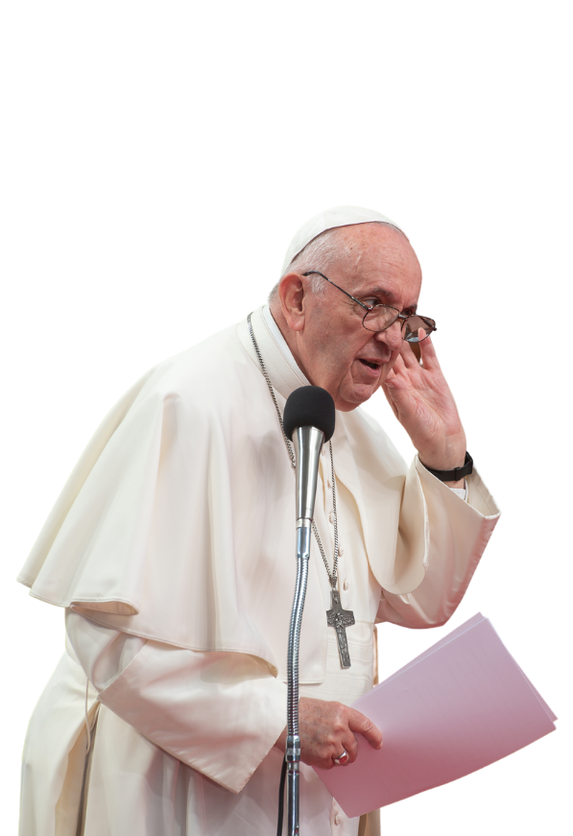
“We ask the Holy Spirit first of all for the gift of listening: to listen to God, that with him we may hear the cry of the people; to listen to the people until breathing in the desire to which God calls us.”
Pope Francis, Apostolic Constitution on the Synod of Bishops, EPISCOPALIS COMMUNIO, n. 6, 2018

Slide 6
Listening does not mean doing nothing. It is a sacred act moved by God’s grace.
It requires openness, conversion of heart, and readiness to accept the challenges that arise from what we hear.

Slide 7
I. The Gift of Listening in the Bible
In the Old Testament, the importance of listening is already evident at the beginning of Israel’s prayer: “Hear, O Israel” (Deuteronomy 6:4).
In Hebrew, the word used is shema, which not only means hearing but also obeying the will of God. Listening implies a relationship rooted in trust, fidelity, and love.

Slide 8
The young Samuel demonstrated the heart of a disciple when he responded to God’s call: “Speak, Lord, for your servant is listening” (1 Samuel 3:10).
The Church is called to listen before it speaks.

Slide 9

When God revealed Himself to Moses in the burning bush, He showed that listening is part of His very nature.
The God who revealed Himself to Moses is a God who listens to the cries of His people: “I have observed the misery of my people who are in Egypt; I have heard their cry” (Exodus 3:7).

Slide 10
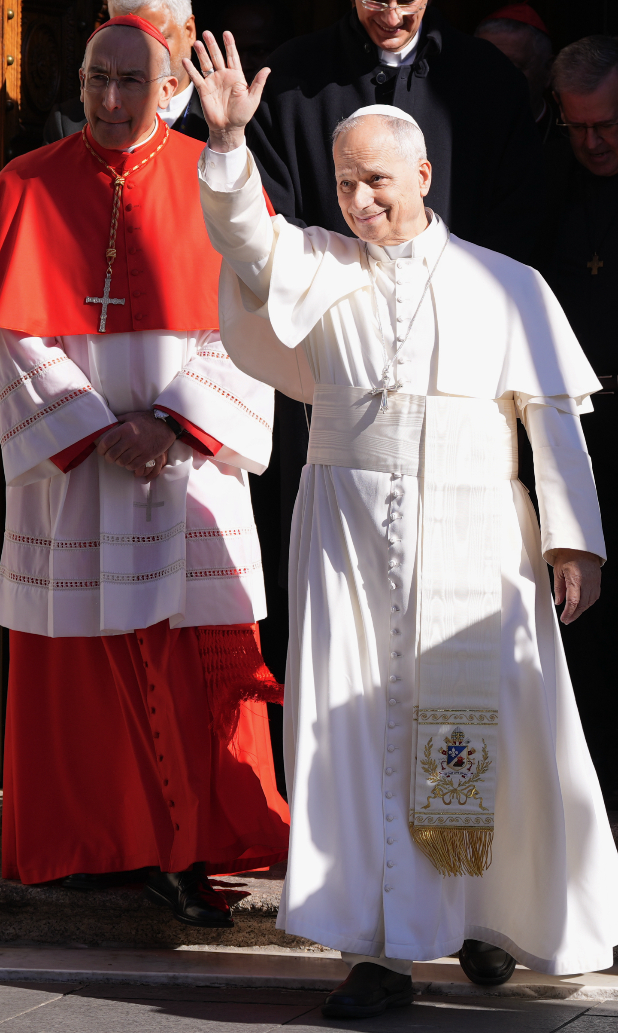
“Hearing the cry of the oppressed is the beginning of a story of liberation in which the Lord calls Moses, sending him to open a path of salvation for his children who have been reduced to slavery.”
Pope Leo XIV, Message for Lent 2026

Slide 11
Here we see that listening is not only receiving a message but also taking on a mission of transformation—participating in God’s work of salvation.
It is a listening that leads to mission.

Slide 12
In the New Testament, especially in the Gospels, we see that Jesus Himself is the perfect listener of His people.
He reveals the importance of listening to the voice of the Father who sent Him and to the cries of the people.

Slide 13
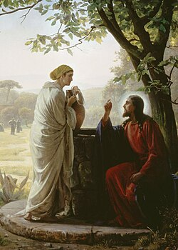
Jesus Himself is the perfect listener. He listens to:
The cry of the blind (Mk 10:46–52)
The Samaritan woman’s story before revealing her deeper thirst (Jn 4:1-26)
The confusion of the disciples on the road to Emmaus (Lk 24:13–35)

Slide 14

II. Listening in the Teachings of the Church

Slide 15
Dei Verbum (Dogmatic Constitution on Divine Revelation) emphasizes that the Church is not only a teacher, but first and foremost a listener of the revealed Word.
Gaudium et Spes (Pastoral Constitution on the Church in the Modern World) rediscovers the call of the Church to listen and “read the signs of the times,” seeking the presence of God in history, culture, suffering, and human hope.
Lumen Gentium (Dogmatic Constitution on the Church) teaches that the whole People of God participates in responding to the call to listen to the voice of God, guided by the Holy Spirit.

Slide 16
Lumen Gentium points to a listening Church—not only listening to God but also within itself—through the sensus fidei (the shared sense of the faithful), where all members participate in discerning the truth, not only the hierarchy.

Slide 17
“A synodal Church is a Church which listens, which realizes that listening ‘is more than simply hearing’. It is a mutual listening in which everyone has something to learn.”
Pope Francis, Ceremony Commemorating the 50th Anniversary of the Institution of the Synod of Bishops, 2015

Slide 18
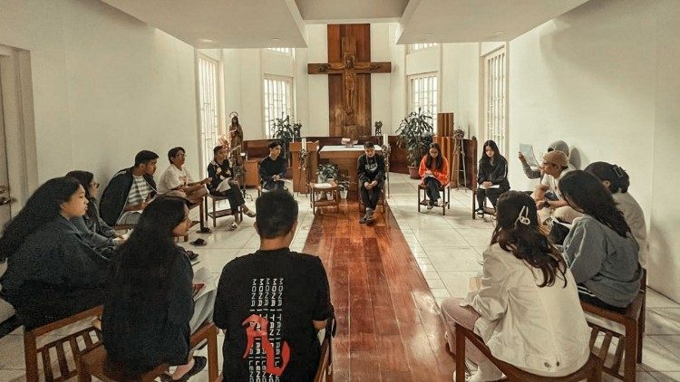
III. Practical Applications:
Creating Spaces for Listening

Slide 19
Creating spaces for listening is not merely about giving people the opportunity to speak,
but about shaping an environment where people feel seen, heard, and valued.

Slide 20
a. In Parishes
1. Structured Listening Sessions
Parish-wide consultations before major decisions
Small group faith-sharing circles
Listening gatherings for marginalized groups
2. Practicing “Conversation in the Spirit”
Training servant-leaders in discernment
Encouraging silence before discussion: “What is the Holy Spirit saying through you?”
3. Accessible Leadership
Ministry of presence
Transparent communication processes
4. Prayer as Foundation
Eucharistic Adoration for communal discernment
Lectio Divina before council meetings

Slide 21
Each parish is challenged to strengthen its Basic Ecclesial Communities (BECs). These become spaces where every member can be heard as part of the Church.
Built on trust and respect for what is shared, these regular gatherings allow people to speak freely and be received with dignity and love.

Slide 22
Another valuable space is the “pastoral assembly”—designated times when priests, lay ministers, or trained volunteers are present to listen, outside of formal confession or counseling.
This helps create a culture where listening is not only for moments of crisis, but a regular part of pastoral care.

Slide 23
b. In Catholic Schools
1. Listening to Students
Anonymous feedback structures
Student faith forums
Safe spaces for moral, psychological, and spiritual questions
2. Listening to Parents
Structured dialogue
Surveys that go beyond satisfaction to spiritual needs
3. Listening to Teachers & Staff
Recollections, regular spiritual and professional reflection spaces
Shared discernment about vision-mission fidelity

Slide 24
c. In the Family & Wider Community
Listening to Families
Accompaniment
Ongoing formation
2. Listening to the Poor
Regular encounters in marginalized communities
Partnerships with Catholic Charities and Apostolates
3. Ecumenical and Interreligious Dialogue
Listening before defending
Shared service projects
4. Engaging Civic Society
Forums on social issues: ecological crisis, systemic corruption, etc.
Collaboration without compromising identity

Slide 25
The Church that truly listens to the works of God does not hear silence, but rather hears a painful cry. The world, once called “very good,” now bears the wounds of human neglect: polluted waters, disappearing forests, and a suffering climate.
These are not merely environmental issues; they are spiritual signs that reveal a broken relationship between humanity and the rest of God’s creation.

Slide 26
Listening means recognizing that care and stewardship are not optional but an essential part of the Christian faith.

Slide 27
Conclusion:
Developing a Culture of Listening
(Archbishop Alberto Uy, Meeting of the Coordinating Council on Synodal Transformation and Secretariat)
1. Make listening a SPIRITUAL HABIT
2. Make listening a PASTORAL ATTITUDE
3. Make listening an ECCLESIAL STRUCTURE

Slide 28
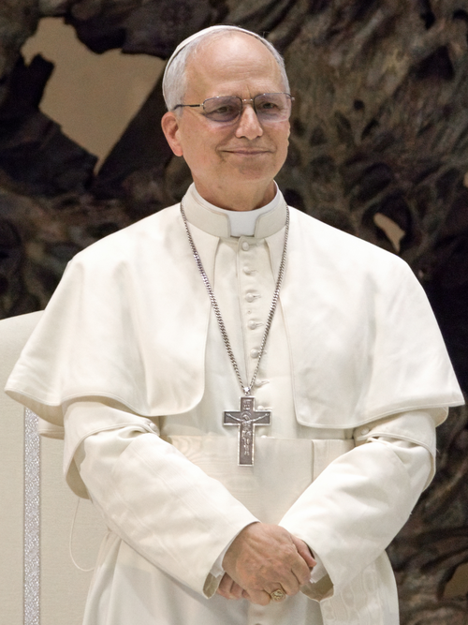
“The willingness to listen is the first way we demonstrate our desire to enter into relationship with someone…In order to foster this inner openness to listening, we must allow God to teach us how to listen as he does.”
Pope Leo XIV, Message for Lent 2026, Listening & Fasting

Slide 29
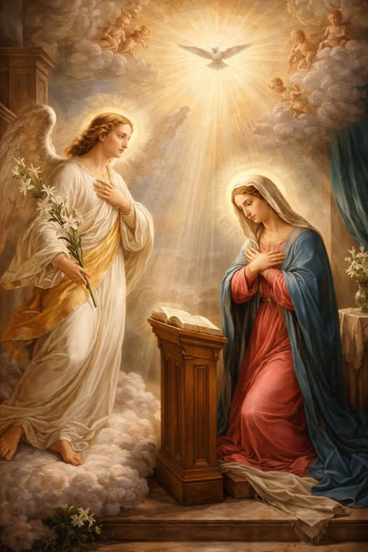
“Let it be done to me according to your word.” Luke 1:38
Among all disciples, Mary stands as the supreme model of listening. Her response at the Annunciation reveals the deepest meaning of biblical listening: openness, trust, surrender, and obedience.
In Mary, listening becomes fruitful; the Word she hears becomes flesh within her.

Slide 30
Questions for Reflection:
1. When do I hear the voice of God in my life?
2. Is our parish/community a listening Church? Why or why not?
3. Who are the people we have not listened to?

Slide 31
A LISTENING CHURCH:
Hearing God’s Voice and the Cries of His People
Introduction
The Gift of Listening in the Bible
Listening in the Teaching of the Church
Practical Applications: Creating Spaces for Listening
Conclusion

